Slide 1
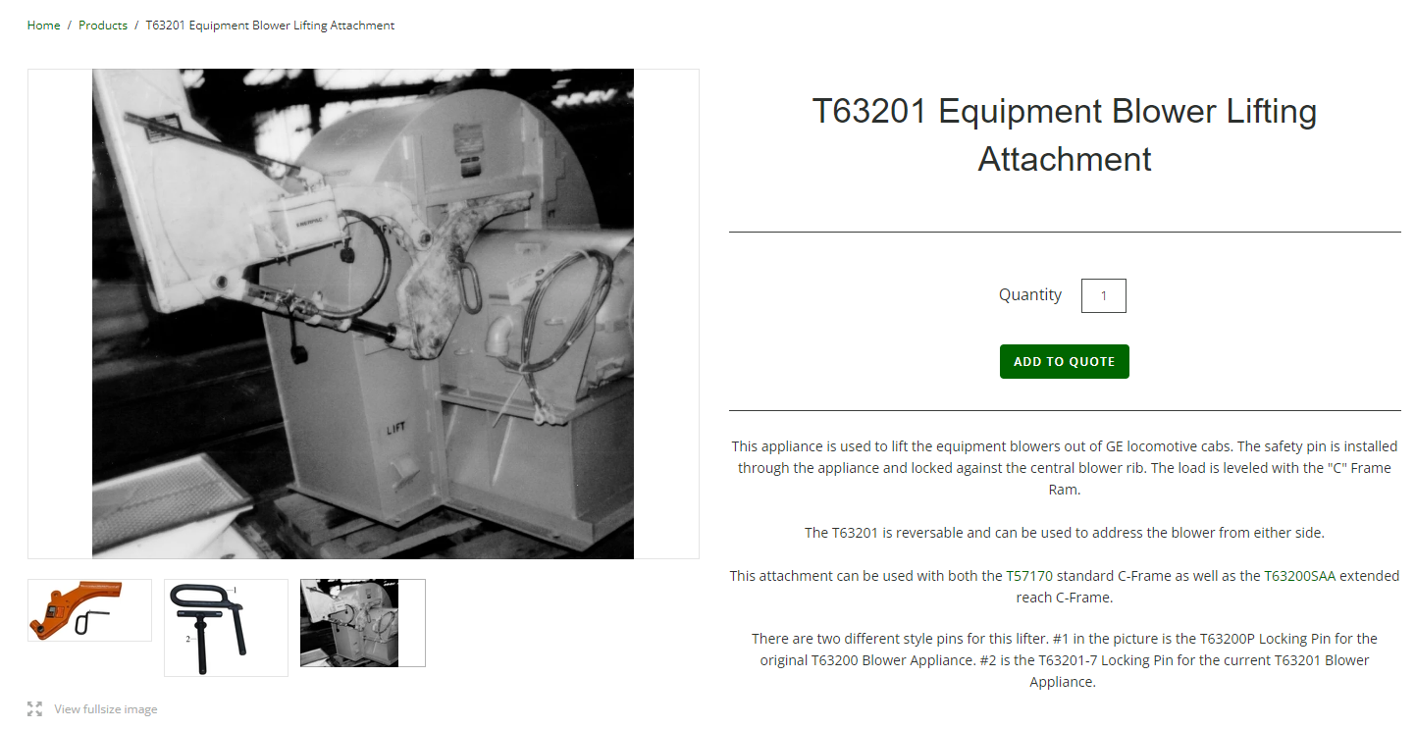
D9/AC4400/Evo Traction Motor Blower Tooling Key Note: This blower comes out engineers' side, on most models until late 2006 on Newer Evo’s

Slide 2
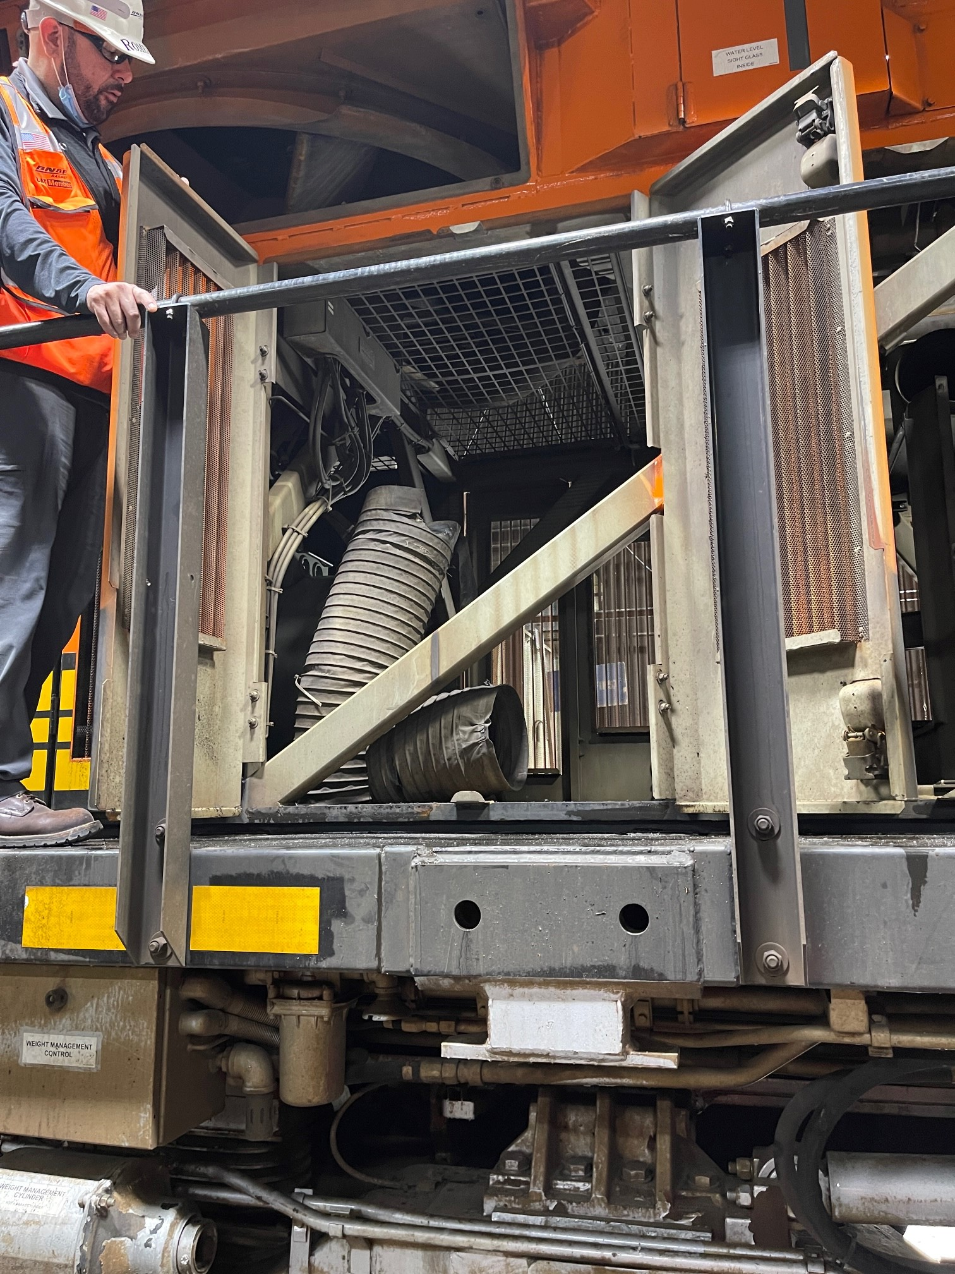
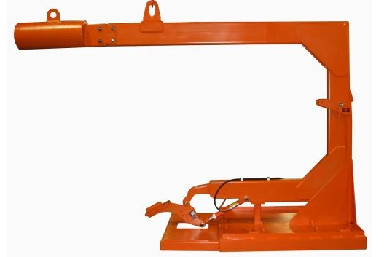
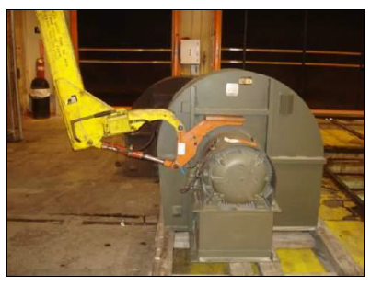
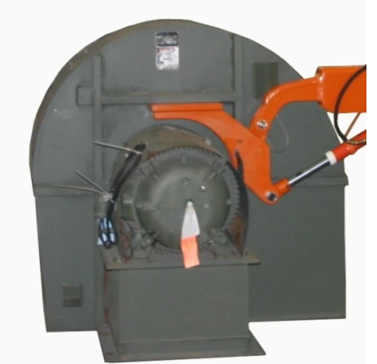
GE EVO Designated Extended Reach Traction Motor Blower and Compressor Lifter – Dec 2006 and later Evo’s
Engineer. Side
Part Number: T63200SAA
This is the regular c-frame when it comes out of the engineer’s side
Most TM Blowers come out of the engineer side. During model changes of Evo’s, this brace was added. When you see this brace, that is the sign you must use this c-frame above with the counterweight for the long reach from the conductor side
If you see this on the engineer side then you need this lifter
Engineer. Side
Conductor
Side
You can see here, it hooks on from the conductor side for
Unit Numbers |  |  | Quantity | Model | Shipped Dates | Fleet
7395 | to | 7504 | 110 | ES44DC | 6/08-12/08 | SFX26
7505 | to | 7524 | 20 | ES44DC | 04/07 - 09/07 | SFX25
7525 | to | 7604 | 80 | ES44DC | 04/07 - 09/07 | SFX25A
6139 | to | 6238 | 100 | ES44AC | 12/06 - 3/07 | SFX24
6239 | to | 6299 | 61 | ES44AC | 9/08 - 12/08 | SFX27
6400 | to | 6415 | 16 | ES44AC | 9/08 - 12/08 | SFX27
 |  | Total | 387
This list is from 2010, so there are hundreds more units that are affected

Slide 3
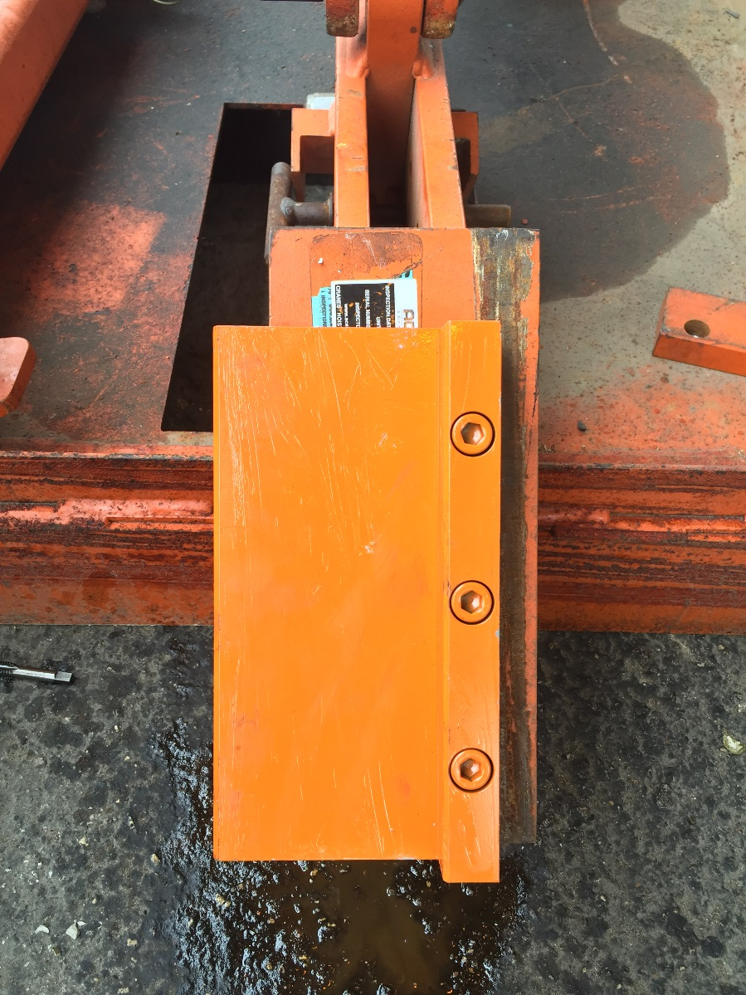
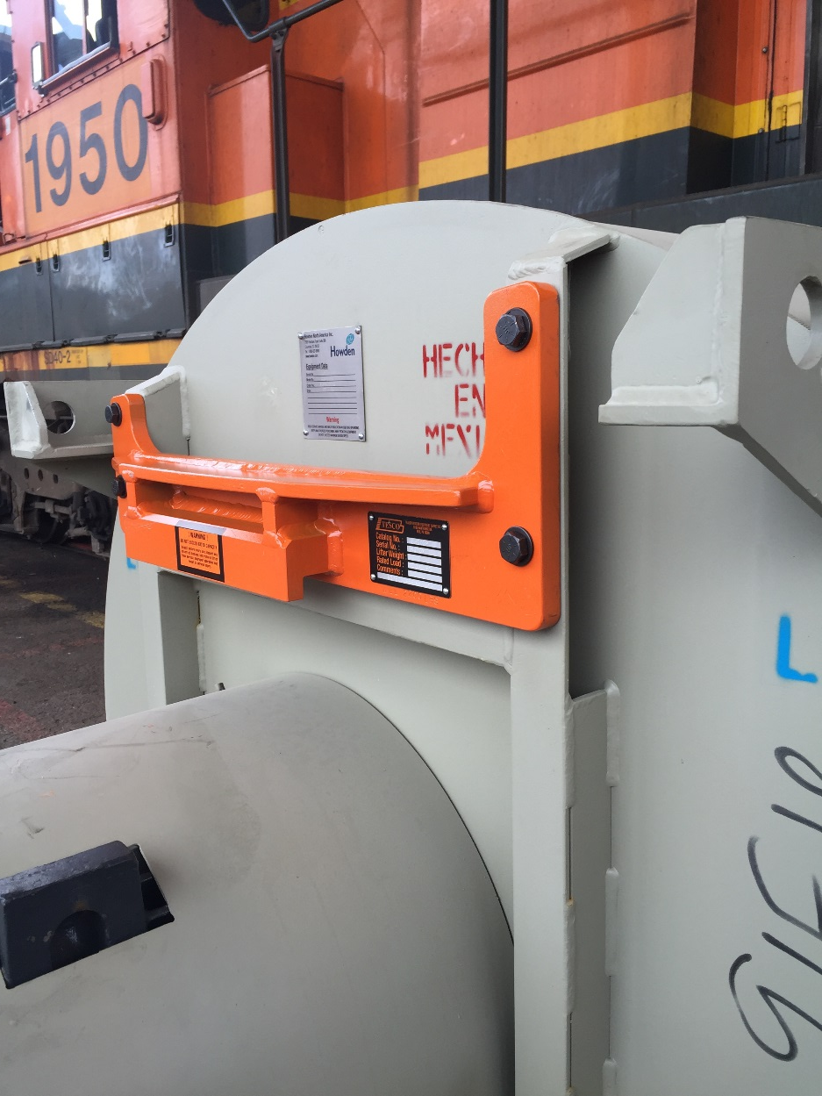
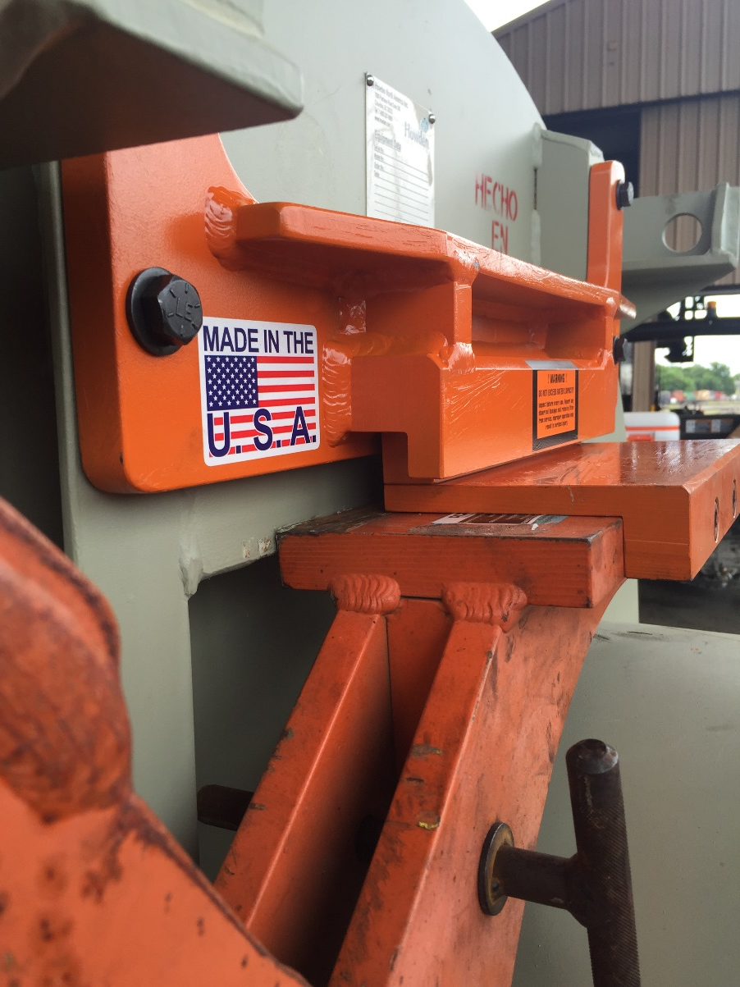
Tier 4 Traction Motor Blower Tooling
Part Number: T63200SAA
T63202P

